Slide 1
An Introduction to
Markov Chain Monte Carlo
Teg Grenager
July 1, 2004

Slide 2
Agenda
Motivation
The Monte Carlo Principle
Markov Chain Monte Carlo
Metropolis Hastings
Gibbs Sampling
Advanced Topics

Slide 3

Monte Carlo principle
Consider the game of solitaire: what’s the chance of winning with a properly shuffled deck?
Hard to compute analytically because winning or losing depends on a complex procedure of reorganizing cards
Insight: why not just play a few hands, and see empirically how many do in fact win?
More generally, can approximate a probability density function using only samples from that density
?
Lose
Lose
Win
Lose
Chance of winning is 1 in 4!

Slide 4
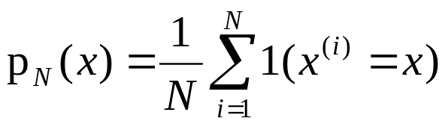
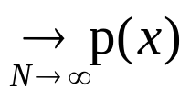
Monte Carlo principle
Given a very large set X and a distribution p(x) over it
We draw i.i.d. a set of N samples
We can then approximate the distribution using these samples
p(x)
X

Slide 5
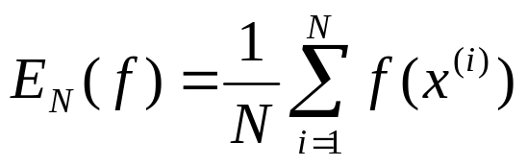
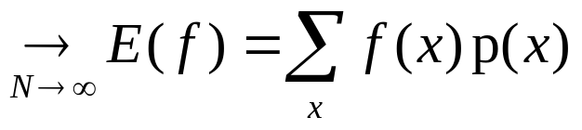
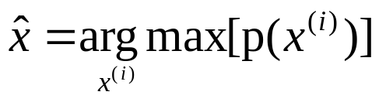
Monte Carlo principle
We can also use these samples to compute expectations
And even use them to find a maximum

Slide 6
Example: Bayes net inference
F
Suppose we have a Bayesian network with variables X
Our state space is the set of all possible assignments of values to variables
Computing the joint distribution is in the worst case NP-hard
However, note that you can draw a sample in time that is linear in the size of the network
Draw N samples, use them to approximate the joint
F
T
T
F
F
T
F
T
T
T
T
F
T
F
F
T
F
Sample 1: FTFTTTFFT
Sample 2: FTFFTTTFF
etc.

Slide 7
Rejection sampling
F
Suppose we have a Bayesian network with variables X
We wish to condition on some evidence ZX and compute the posterior over Y=X-Z
Draw samples, rejecting them when they contradict the evidence in Z
Very inefficient if the evidence is itself improbable, because we must reject a large number of samples
F
T
T
F
F
T
F
T
F=
T
T
T
F
T
=T
F
F
T
F
Sample 1: FTFTTTFFT reject
Sample 2: FTFFTTTFF accept
etc.

Slide 8
Rejection sampling
More generally, we would like to sample from p(x), but it’s easier to sample from a proposal distribution q(x)
q(x) satisfies p(x)  M q(x) for some M<
Procedure:
  Sample x^{(i)} from q(x)
  Accept with probability p(x^{(i)}) / Mq(x^{(i)})
  Reject otherwise
The accepted x^{(i)} are sampled from p(x)!
Problem: if M is too large, we will rarely accept samples
  In the Bayes network, if the evidence Z is very unlikely then we will reject almost all samples

Slide 9
Markov chain Monte Carlo
Recall again the set X and the distribution p(x) we wish to sample from
Suppose that it is hard to sample p(x) but that it is possible to “walk around” in X using only local state transitions
Insight: we can use a “random walk” to help us draw random samples from p(x)
p(x)
X

Slide 10

Markov chains
Markov chain on a space X with transitions T is a random process (infinite sequence of random variables) (x⁽⁰⁾, x⁽¹⁾,…x^{(t)},…)  X that satisfy
That is, the probability of being in a particular state at time t given the state history depends only on the state at time t-1
If the transition probabilities are fixed for all t, the chain is considered homogeneous
0.4
0.7
0.3
0
x₂
0.3
0.3
T=
0.3
0.4
0.3
0.3
0
0.7
0.3
0.7
0.3
0.7
x₁
x₃

Slide 11
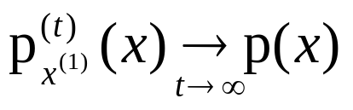

Markov Chains for sampling
In order for a Markov chain to useful for sampling p(x), we require that for any starting state x⁽¹⁾
Equivalently, the stationary distribution of the Markov chain must be p(x)
If this is the case, we can start in an arbitrary state, use the Markov chain to do a random walk for a while, and stop and output the current state x^{(t)}
The resulting state will be sampled from p(x)!

Slide 12
Stationary distribution
Consider the Markov chain given above:
The stationary distribution is
Some samples:
0.4
0.7
0.3
0
x₂
0.3
0.3
T=
0.3
0.4
0.3
0.3
0
0.7
0.3
0.7
0.3
0.7
x₁
x₃
0.7
0.3
x
0
0.33
=
0.33
0.33
0.33
0.33
0.33
0.3
0.4
0.3
0
0.3
0.7
1,1,2,3,2,1,2,3,3,2
1,2,2,1,1,2,3,3,3,3
1,1,1,2,3,2,2,1,1,1
1,2,3,3,3,2,1,2,2,3
1,1,2,2,2,3,3,2,1,1
1,2,2,2,3,3,3,2,2,2
Empirical Distribution:
0.33
0.33
0.33

Slide 13
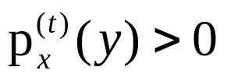
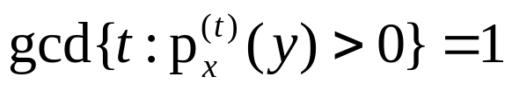
Ergodicity
Claim: To ensure that the chain converges to a unique stationary distribution the following conditions are sufficient:
  Irreducibility: every state is eventually reachable from any start state; for all x,yX there exists a t such that
  Aperiodicity: the chain doesn’t get caught in cycles; for all x,yX it is the case that
The process is ergodic if it is both irreducible and aperiodic
This claim is easy to prove, but involves eigenstuff!

Slide 14

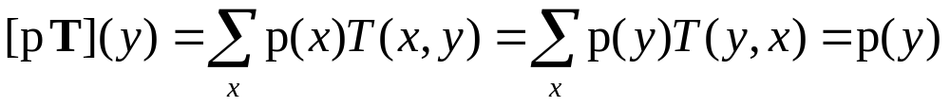
Markov Chains for sampling
Claim: To ensure that the stationary distribution of the Markov chain is p(x) it is sufficient for p and T to satisfy the detailed balance (reversibility) condition:
Proof: for all y we have
And thus p must be a stationary distribution of T

Slide 15
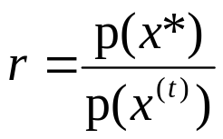
Metropolis algorithm
How to pick a suitable Markov chain for our distribution?
Suppose our distribution p(x) is easy to sample, and easy to compute up to a normalization constant, but hard to compute exactly
  e.g. a Bayesian posterior P(M|D)P(D|M)P(M)
We define a Markov chain with the following process:
  Sample a candidate point x* from a proposal distribution q(x*|x^{(t)}) which is symmetric: q(x|y)=q(y|x)
  Compute the importance ratio (this is easy since the normalization constants cancel)
  With probability min(r,1) transition to x*, otherwise stay in the same state

Slide 16
Metropolis intuition
Why does the Metropolis algorithm work?
  Proposal distribution can propose anything it likes (as long as it can jump back with the same probability)
  Proposal is always accepted if it’s jumping to a more likely state
  Proposal accepted with the importance ratio if it’s jumping to a less likely state
The acceptance policy, combined with the reversibility of the proposal distribution, makes sure that the algorithm explores states in proportion to p(x)!
Now, network permitting, the MCMC demo…
r=1.0
r=p(x*)/p(x^{t})
x*
x^{t}
x*

Slide 17
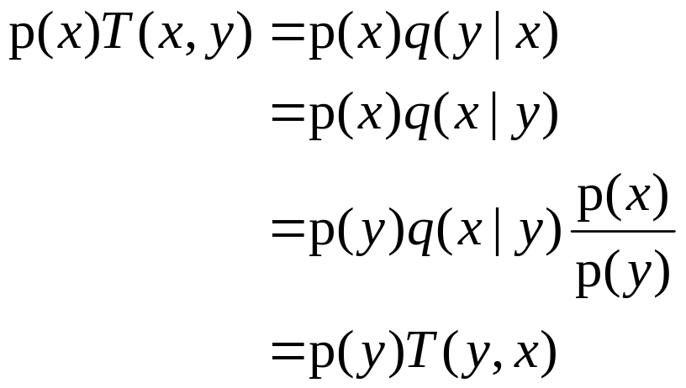
Metropolis convergence
Claim: The Metropolis algorithm converges to the target distribution p(x).
Proof: It satisfies detailed balance
  For all x,yX, wlog assuming p(x)p(y)
candidate is always
accepted b/c p(x)p(y)
q is symmetric
transition prob b/c p(x)p(y)

Slide 18
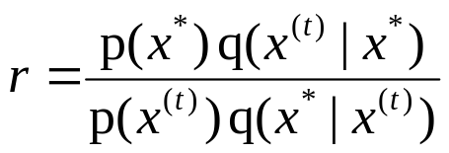
Metropolis-Hastings
The symmetry requirement of the Metropolis proposal distribution can be hard to satisfy
Metropolis-Hastings is the natural generalization of the Metropolis algorithm, and the most popular MCMC algorithm
We define a Markov chain with the following process:
  Sample a candidate point x* from a proposal distribution q(x*|x^{(t)}) which is not necessarily symmetric
  Compute the importance ratio:
  With probability min(r,1) transition to x*, otherwise stay in the same state x^{(t)}

Slide 19
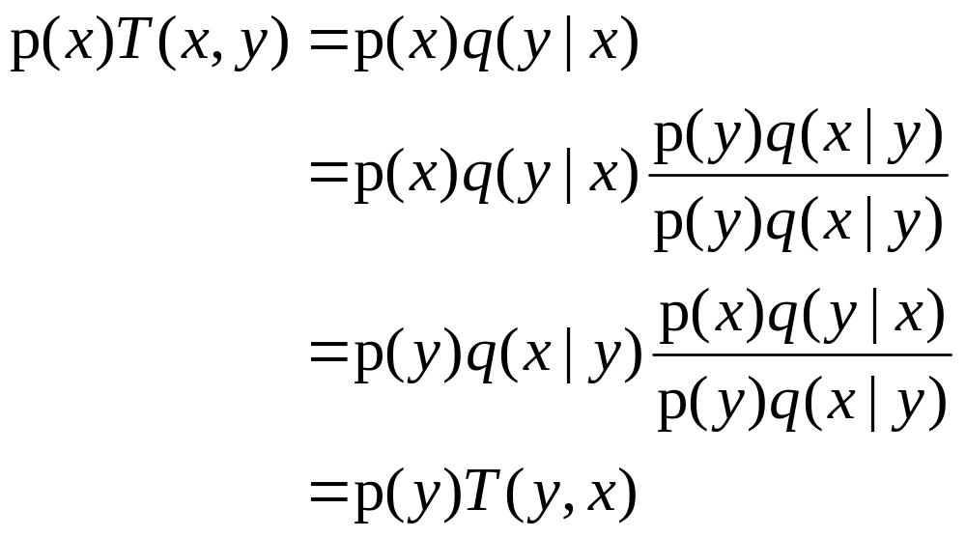
MH convergence
Claim: The Metropolis-Hastings algorithm converges to the target distribution p(x).
Proof: It satisfies detailed balance
  For all x,yX, wlog assume p(x)q(y|x)p(y)q(x|y)
candidate is always accepted
b/c p(x)q(y|x)p(y)q(x|y)
transition prob
b/c p(x)q(y|x)p(y)q(x|y)

Slide 20
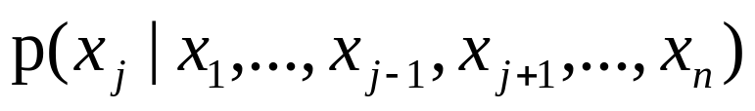
Gibbs sampling
A special case of Metropolis-Hastings which is applicable to state spaces in which we have a factored state space, and access to the full conditionals:
Perfect for Bayesian networks!
Idea: To transition from one state (variable assignment) to another,
  Pick a variable,
  Sample its value from the conditional distribution
  That’s it!
We’ll show in a minute why this is an instance of MH and thus must be sampling from the full joint

Slide 21

Markov blanket
Recall that Bayesian networks encode a factored representation of the joint distribution
Variables are independent of their non-descendents given their parents
Variables are independent of everything else in the network given their Markov blanket!
So, to sample each node, we only need to condition its Markov blanket

Slide 22



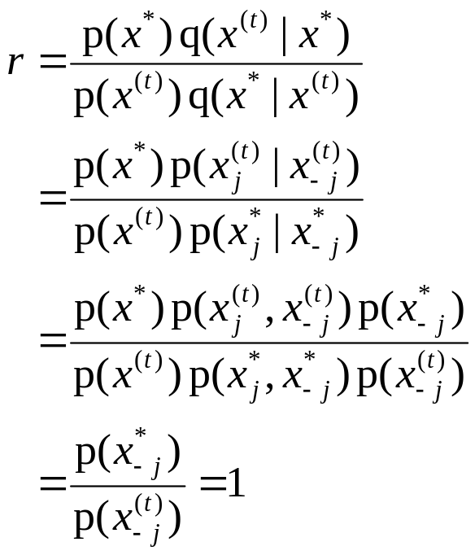
Gibbs sampling
More formally, the proposal distribution is
The importance ratio is
So we always accept!
if x*_{-j}=x^{(t)}_{-j}
otherwise
Dfn of proposal distribution
Dfn of conditional probability
B/c we didn’t change other vars

Slide 23
Gibbs sampling example
Consider a simple, 2 variable Bayes net
Initialize randomly
Sample variables alternately
 | a | -a
 | 0.5 | 0.5
A
T
T
F
F
T
T
 | b | -b
a
-a
 | b | -b
a | 0.8 | 0.2
-a | 0.2 | 0.8
1
1
B
F
F
T
T
1
1
1

Slide 24
Practical issues
How many iterations?
How to know when to stop?
What’s a good proposal function?

Slide 25
Advanced Topics
Simulated annealing, for global optimization, is a form of MCMC
Mixtures of MCMC transition functions
Monte Carlo EM (stochastic E-step)
Reversible jump MCMC for model selection
Adaptive proposal distributions

Slide 26

Cutest boy on the planet

